Slide 1
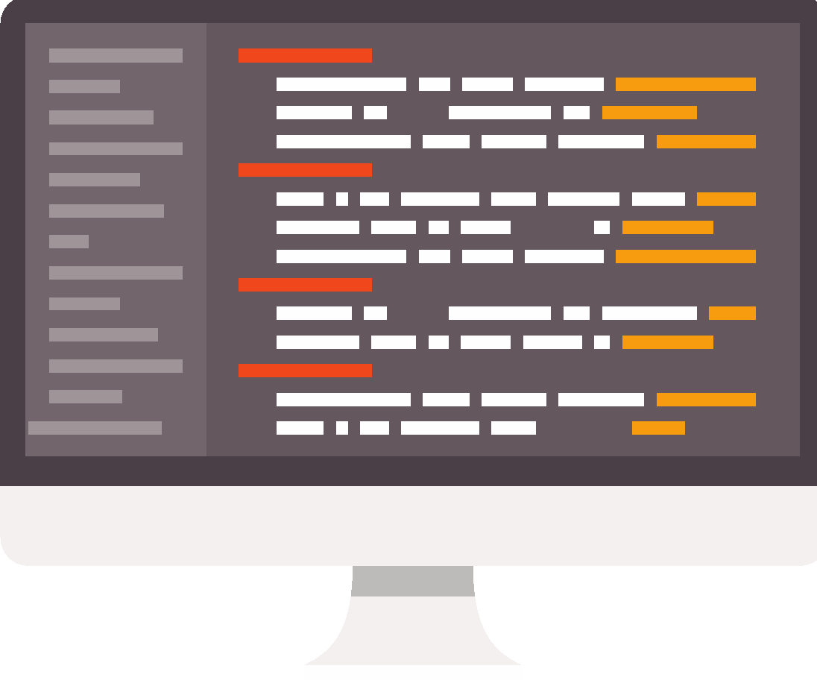
Programming in Python: sequence
Lesson 1: Computer programs

Slide 2
Objectives
In this lesson you will learn:
about the widespread use of computer programming
how to write a simple program in Python
about variables and how they are used to store data in a program.

Slide 3
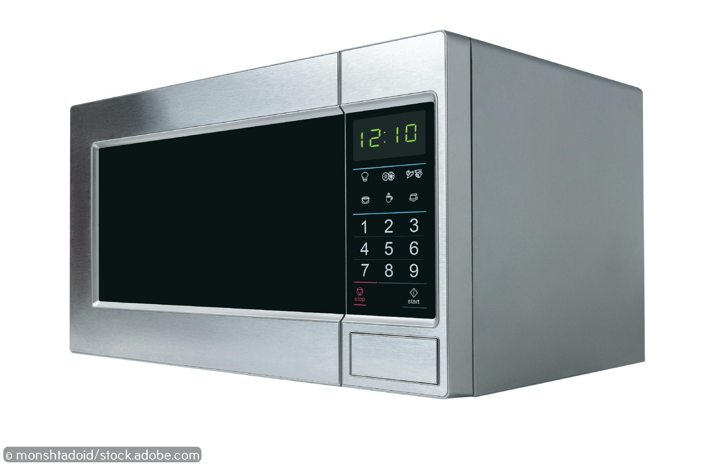
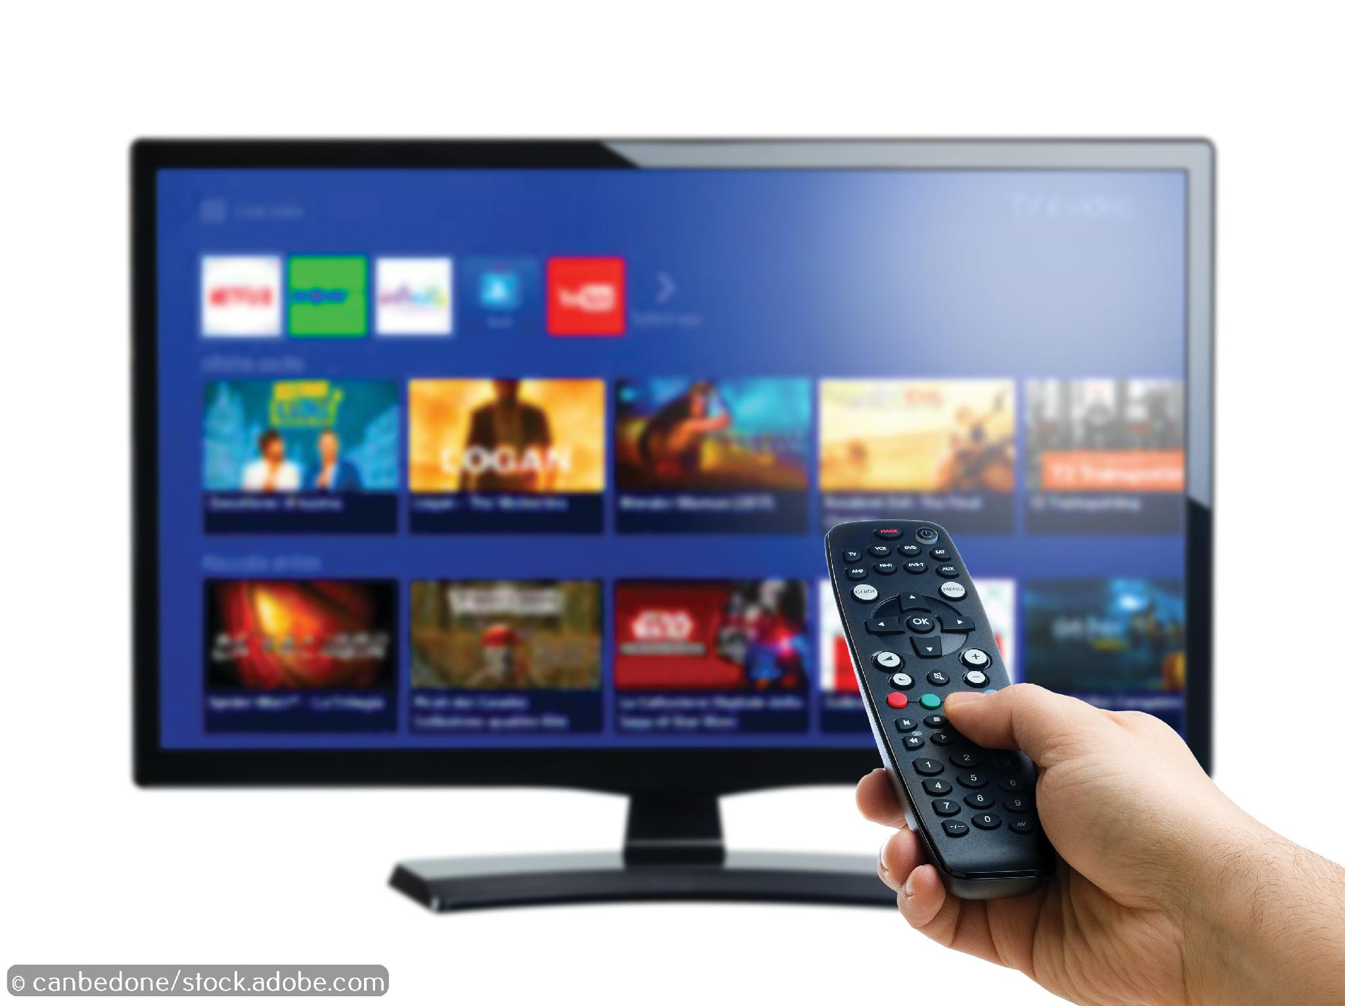
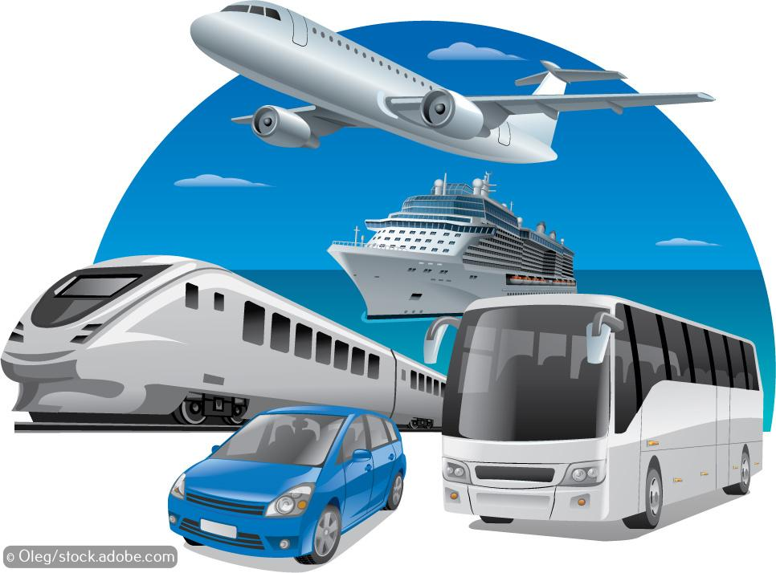

Computer programs are everywhere
We are surrounded by devices that require computer programs to work.
We rely on computer programs to:
bring us entertainment
access our bank accounts online
shop online
cook our food
move from one place to another.

Slide 4
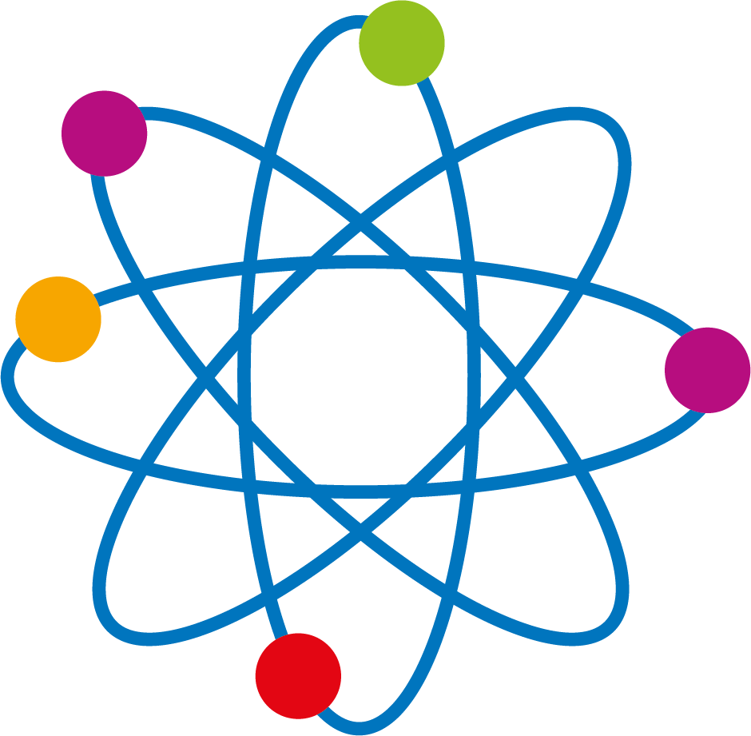
Activity 1.1: Smart devices and programming
1. There are up to 50 computers in a car.
2. C or C++ is used to program a car computer.
3. An internet-connected refrigerator senses what is inside it and keeps track of stock using the barcodes on products. It can suggest items for a shopping lists or recipes based on the contents of the fridge.
4. A smart doorbell provides the householder with a video and audio link to anyone outside the house who uses the bell. It can also be activated by motion sensors so the householder can see who is outside the door even if they do not ring the bell.
5. Assembly language, a low-level programming language, is used to program microprocessors and microcontrollers for computerised products such as washing machines.
6. Amazon Echo (Alexa) uses Java, JavaScript, Python, C# or Go.

Slide 5
Programming languages
Programmers use many different programming languages to write computer programs, and each programming language was designed for a specific purpose. For example:
Java is used to code video games, mobile apps, as well as Google Docs.
Ruby is used to code web apps.
JavaScript is used to add interactive elements to websites.
SQL is used to access data in a database.
Low-level and assembly languages are used to create programs that directly control hardware, such as printers and washing machines.
Python is one of the most popular programming languages in the world. It is used to code web apps and in game development, artificial intelligence and a lot more.
With simple syntax and English-like commands, Python is easy to read and one of the easiest languages to learn. According to www.techrepublic.com, ‘Python developer’ was one of the top 10 in-demand tech jobs in 2019.

Slide 6
What is a computer program?
A computer program is a set of instructions that a computer follows precisely.
This means that a computer program must accurately describe what the computer has to do if it is to work as we expect it to.
The instructions must also be correctly sequenced because the computer will carry out each instruction in turn.

Slide 7
Activity 1.2: Finding the way to the exit

Slide 8
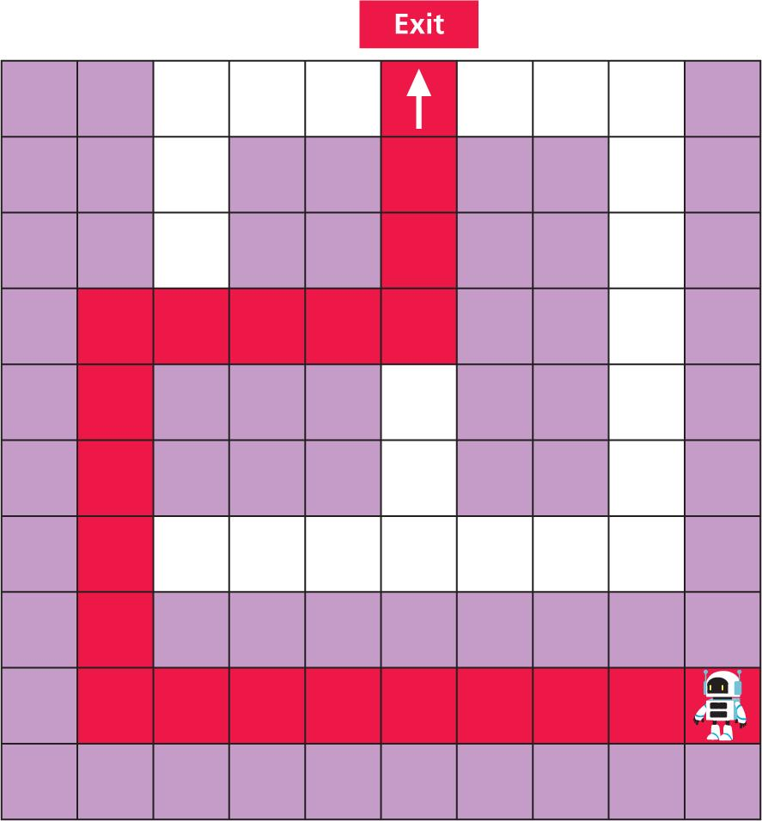
More than one solution
There is more than one way to program the robot to find the exit. Here is one solution:
            fd 8
            rt 90
            fd 5
            rt 90
            fd 4
            lt 90
            fd 3
Just as there is more than one way to program the robot to find the exit, there is often more than one way to write most computer programs.
cs
rt -90
fd 100
rt 90
fd 100
rt 90
fd 50
rt -90
fd 50

Slide 9
Activity 1.3: Programming in Python: sequence, Section 1
https://www.w3schools.com/python/python_variables.asp

Slide 10
Quiz 1

